Slide 1
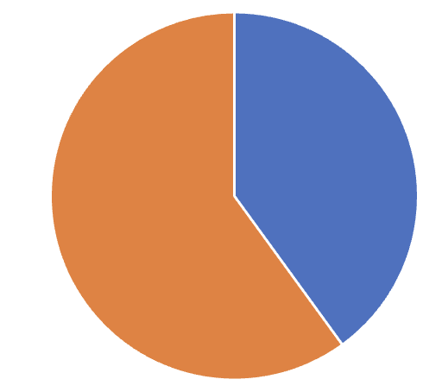
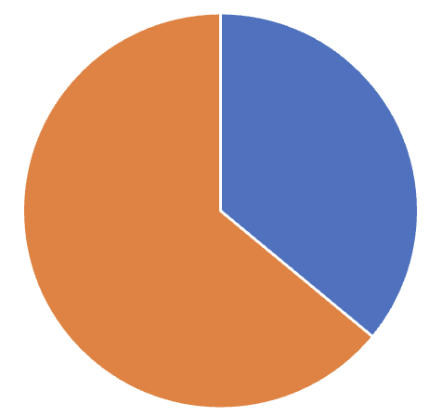
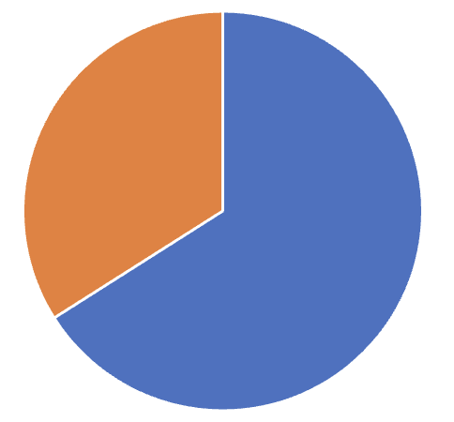
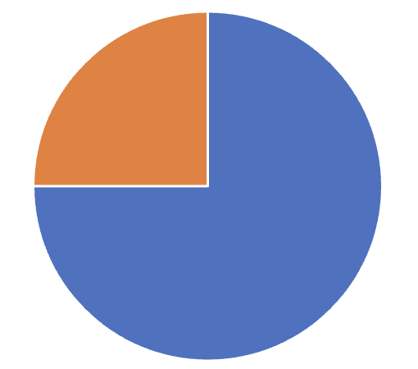
How effective are psychological therapies for treating functional / dissociative seizures? A series of meta-analyses
Chris Gaskell, Niall Power, Barbora Novakova, Melanie Simmonds-Buckley, Wesley T. Kerr, Markus Reuber, Stephen Kellet, Gregg H. Rawlings*
Gregg.Rawlings@Sheffield.ac.uk
Introduction
Psychological interventions, such as Cognitive Behavioural Therapy (CBT), Psychodynamic psychotherapy and Acceptance and Commitment Therapy (ACT), are the most commonly recommended treatments for adults presenting with functional / dissociative seizures (FDS; also known as psychogenic non-epileptic seizures or non-epileptic attacks).
Although a range of trials have been published in this area, there is still uncertainty regarding: (1) how effective psychological treatments are for FDS; (2) what treatment conditions are most conducive to treatment effectiveness (i.e., group vs individual therapy, the use of different therapeutic modalities); (3) who is more likely to benefit from therapy; (4) how durable clinical improvements are following treatment completion; and (5) which outcome measures are most sensitive to treatment-related change (i.e., seizure-related outcomes vs non-seizure related outcomes).
We set out to address these questions via a systematic review of the evidence and a series of meta-analytic analyses.
Methods
Our review follows PRISMA guidelines for systematic reviews and meta-analyses (1,2).
We performed a systematic search of four electronic databases (CINAHL, PsychINFO, Medline, and Cochrane Reviews) to identify relevant articles in February 2022, with a repeat search in 2023 to allow for additional analyses.
Studies must have included adults with FDS receiving any form of psychological therapy and where self-reported outcome measures were administered to measure treatment effectiveness.
Risk of bias (RoB) was assessed using the Cochrane Collaboration tool for assessing risk of bias (ROB-2). The quality of evidence was further assessed using the Grading of Recommendations Assessment, Development, and Evaluation (GRADE) approach.
All analyses were conducted in R using the metafor package.
Results
Fig 1. Pooled effect size for each outcome pre vs post treatment
Data from up to 1300 individuals across 44 studies were analysed.
Data points for 171 non-seizure related and 135 seizure-related outcomes were analysed.
Seizure frequency was the commonest outcome measure; however, there is great variation in how it is measured.
Most studies were catergorised as “high” or “medium” RoB.
Meta-analyses were judged to be “low” based on GRADE criteria.
None of the included moderators were significant for seizure frequency; for non-seizure related outcomes, the focus of the measure (e.g., measure of functioning vs HRQoL; Fig 1) and type of treatment significantly moderated the outcome. Treatments with a behavioural focus were associated with greater outcomes, although the number of trials were limited. Age, gender, RoB or interventions characteristics (delivery format, delivery setting or treatment length) were not significant moderators.
Psychological interventions appear to be most effective for the reduction, as opposed to cessation, of seizure frequency (Fig 2).
On the group level, treatment was associated with an improvement of 6.5 seizures per month.
Cohen’s d
Fig 2. What % of patients reported…
Seizure Freedom
Seizure Improvement
40%
36%
66%
75%
Conclusion
Post treatment
Follow up
Post treatment
Follow up
This body of work represents the most comprehensive review of the data collected investigating psychological interventions for FDS.
Findings suggest psychological treatments are associated with improvements in seizure-related and non-seizure-related outcomes.
While several moderator analyses could be performed, these findings should be interpreted with caution recognising the limited amount of data that could be included and the observational nature of analyses. While there is a considerable number of trials, the variability in research methodologies and the reporting of findings hindered some attempts at collating the results.
Further research on the most appropriate measure to capture treatment-related change in people with FDS is needed.
Gaskell, C., Power, N., Novakova, B., Simmonds-Buckley, M., Reuber, M., Kellet, S., & Rawlings, GH., (2023). A meta-analytic review of the effectiveness of psychological treatment of functional / dissociative seizures in adults. Epilepsia, 64(7), 1722-1738.
Gaskell, C., Power, N., Novakova, B., Simmonds-Buckley, M., Kerr, W.T., Reuber, M., Kellet, S., & Rawlings, GH., (In Press). The effectiveness of psychological therapy for treatment of functional seizures in adults – focus on seizure frequency: A meta-analysis. Seizure: European Journal of Epilepsy

